Slide 1
성남 유통센터 통신도면 (주차유도최종)-구역제어기위치변경_Zone변경-3
USM-LGM Serial Number

Slide 2
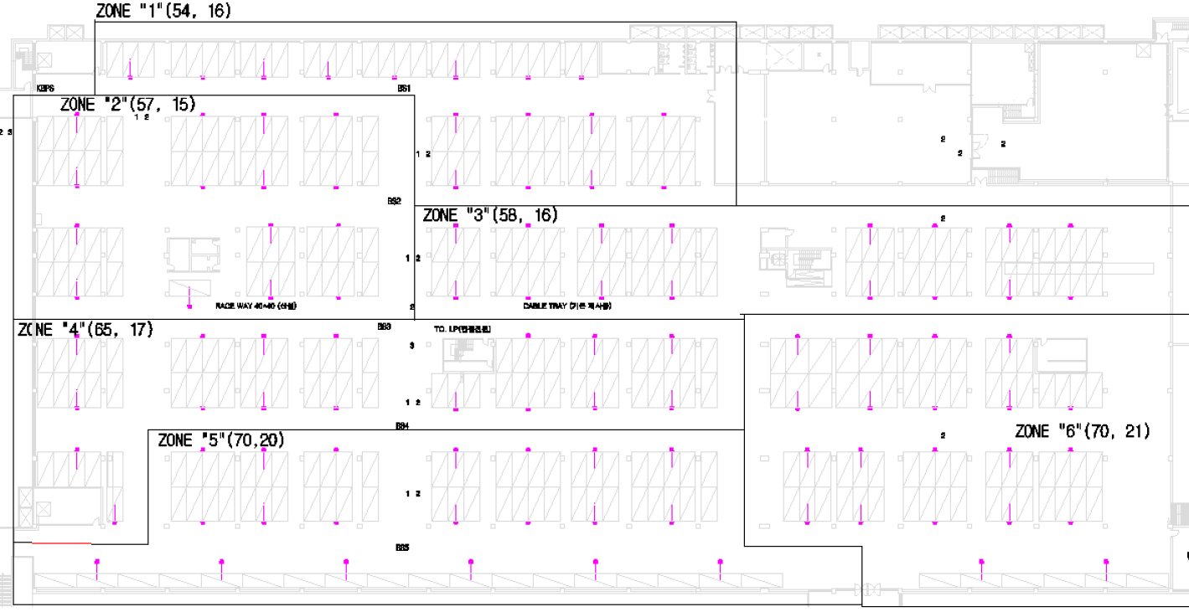

Slide 3
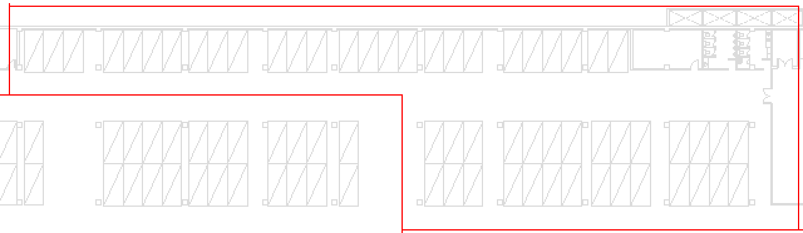
ZONE 1
SCM(54) : 4795~4830, 4457~4474
LGM(16) : 1571~1586
4795
4798
4803
4806
4809
4813
4816
4820
1571
1572
1573
1574
1575
1576
1577
1578
1579
1580
1581
1582
4821
4822
4825
4829
4457
4930
4458
4474
4469
4466
4462
4473
1586
1585
1584
1583

Slide 4
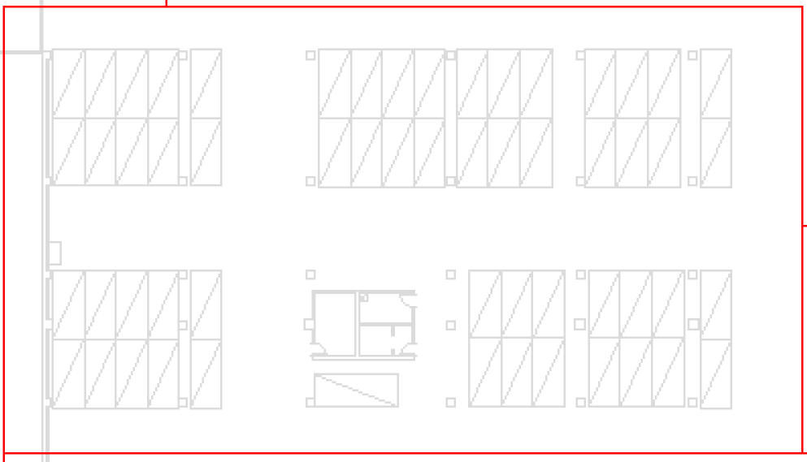
ZONE 2
SCM(57) : 4475~4531
LGM(15) : 1587~1601
1590
1589
1588
1587
4488
4486
4483
4480
4477
4475
4492
4495
4497
4501
4504
4506
1591
1592
1593
1594
1597
1596
1595
4518
4516
4514
4512
4509
4507
4519
4520
4523
4526
4529
4531
4524
1598
1599
1600
1601

Slide 5
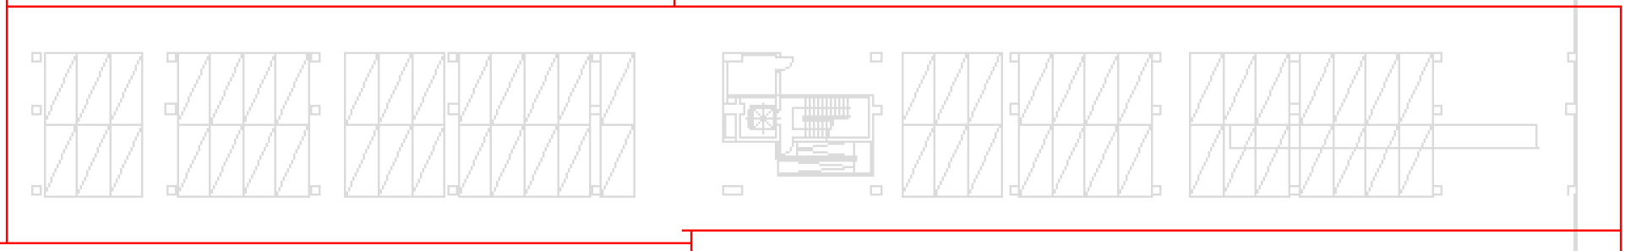
ZONE 3
SCM(58) : 4532~4589
LGM(16) : 1602~1617
1617
1616
1615
1614
1613
1612
1611
1610
4588
4584
4581
4577
4575
4573
4569
4566
4562
4589
4532
4536
4540
4543
4546
4548
4551
4555
4533
4558
4560
1602
1603
1604
1605
1606
1607
1608
1609

Slide 6
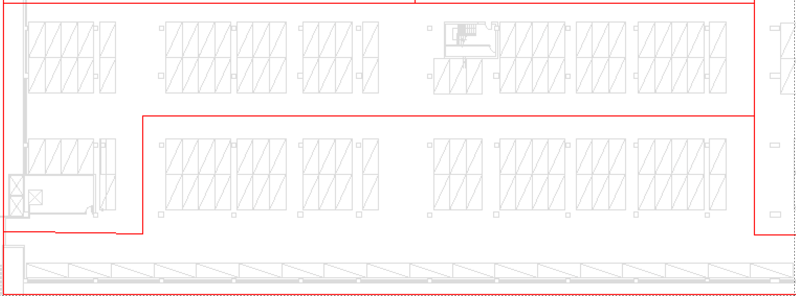
ZONE 4
SCM(65) : 4590~4654
LGM(17) : 1618~1633
1618
1619
1620
1621
1622
1623
1624
4590
4594
4596
4600
4603
4605
4607
4611
4614
4617
4591
4648
4646
4644
4641
4638
4635
4633
4631
4627
4624
4620
4618
1632
1631
1630
1629
1628
1627
1626
1625
1633
1635
1636
1637
1638
1639
1640
1641
4649
4651
4653
4655
4663
4667
4670
4674
4677
4656
4660
4665
4680
4654
4706
4704
4701
4698
4696
4694
4690
4687
4683
4681
1634
1648
1647
1646
1645
1644
1643
1642
1649
1650
1651
1652
1653
1654
4707
4708
4711
4714
4717
4720
4723
4724
SCM(70) : 4655~4724
LGM(20) : 1635~1654
ZONE 5

Slide 7
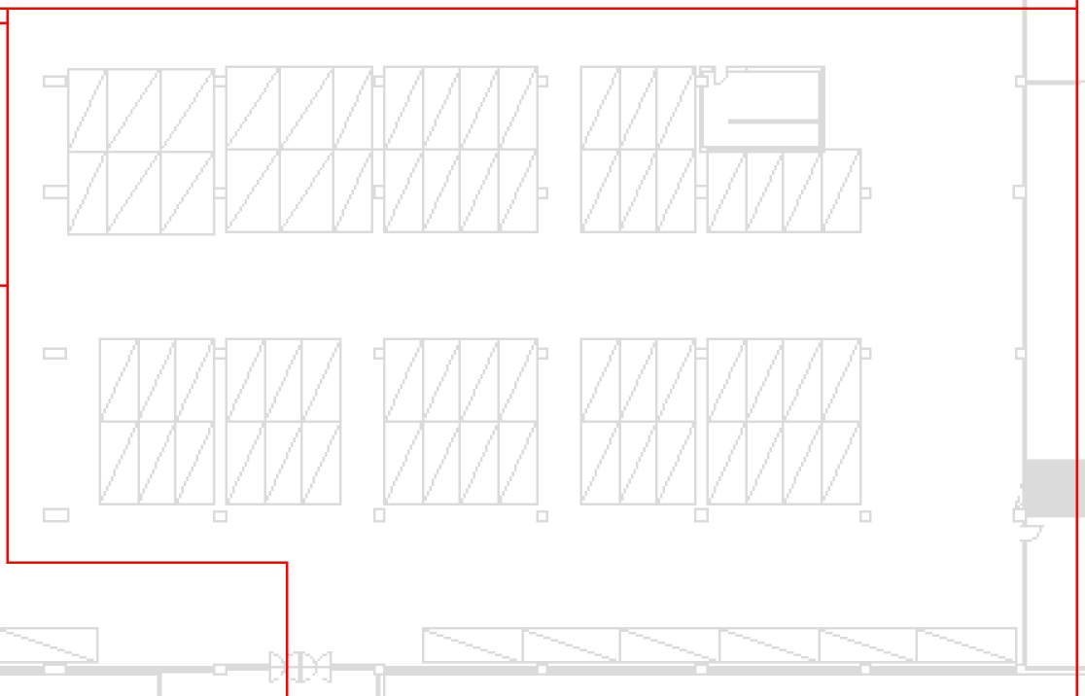
ZONE 6
SCM(70) : 4725~4794
LGM(21) : 1655~1670, 1551~1555
1552
1553
1554
1555
4789
4793
4782
4794
4783
4786
4781
4777
4773
4770
4780
4766
4765
1551
1670
1669
1668
1667
1662
1663
1664
1665
1666
4749
4752
4755
4759
4762
4764
4746
4743
4739
4736
4732
4731
1661
1660
1659
1658
1657
1655
1656
4725
4726
4729

